Slide 1

Advancements in Facial Recognition Technology

Slide 2

Introduction
Facial recognition technology has revolutionized security and efficiency in various industries. Its applications range from law enforcement to consumer electronics, impacting our daily lives. This presentation will explore the advancements and implications of this cutting-edge technology.

Slide 3

History of Facial Recognition
The concept of facial recognition dates back to the 1960s, but recent breakthroughs in machine learning and artificial intelligence have propelled the technology to new heights. Advancements in algorithms and hardware have significantly improved accuracy and speed.

Slide 4

Facial Biometrics
Facial recognition relies on biometric data such as unique facial features, patterns, and expressions. The technology utilizes deep learning algorithms to identify individuals with high precision, making it a valuable tool for security and authentication purposes.

Slide 5

Law enforcement agencies leverage facial recognition to identify suspects, locate missing persons, and enhance public safety. The technology has proven instrumental in solving cold cases and preventing criminal activities, leading to a safer society.
Applications in Law Enforcement

Slide 6

Security and Access Control
Facial recognition has streamlined access control systems in various environments, including airports, corporate offices, and residential buildings. Its contactless nature and high accuracy make it an ideal solution for secure authentication and surveillance.

Slide 7
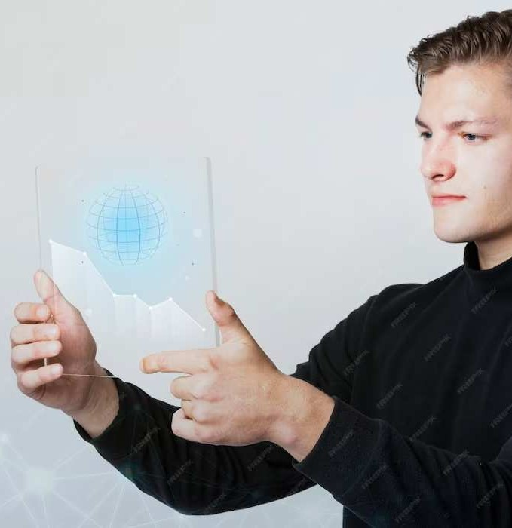
Challenges and Ethical Considerations
While facial recognition offers numerous benefits, it also raises concerns regarding privacy, bias, and misuse of data. Striking a balance between innovation and ethical considerations is crucial to ensure the responsible deployment of this technology.

Slide 8
Advancements in Machine Learning
Machine learning algorithms have significantly improved the accuracy and speed of facial recognition systems. Deep neural networks and convolutional neural networks have enabled rapid processing of vast amounts of facial data, leading to enhanced performance.

Slide 9

Consumer Electronics Integration
Facial recognition has become a prominent feature in consumer electronics, including smartphones, tablets, and smart home devices. Its seamless integration enhances user convenience and personalized experiences, showcasing the widespread adoption of this technology.

Slide 10
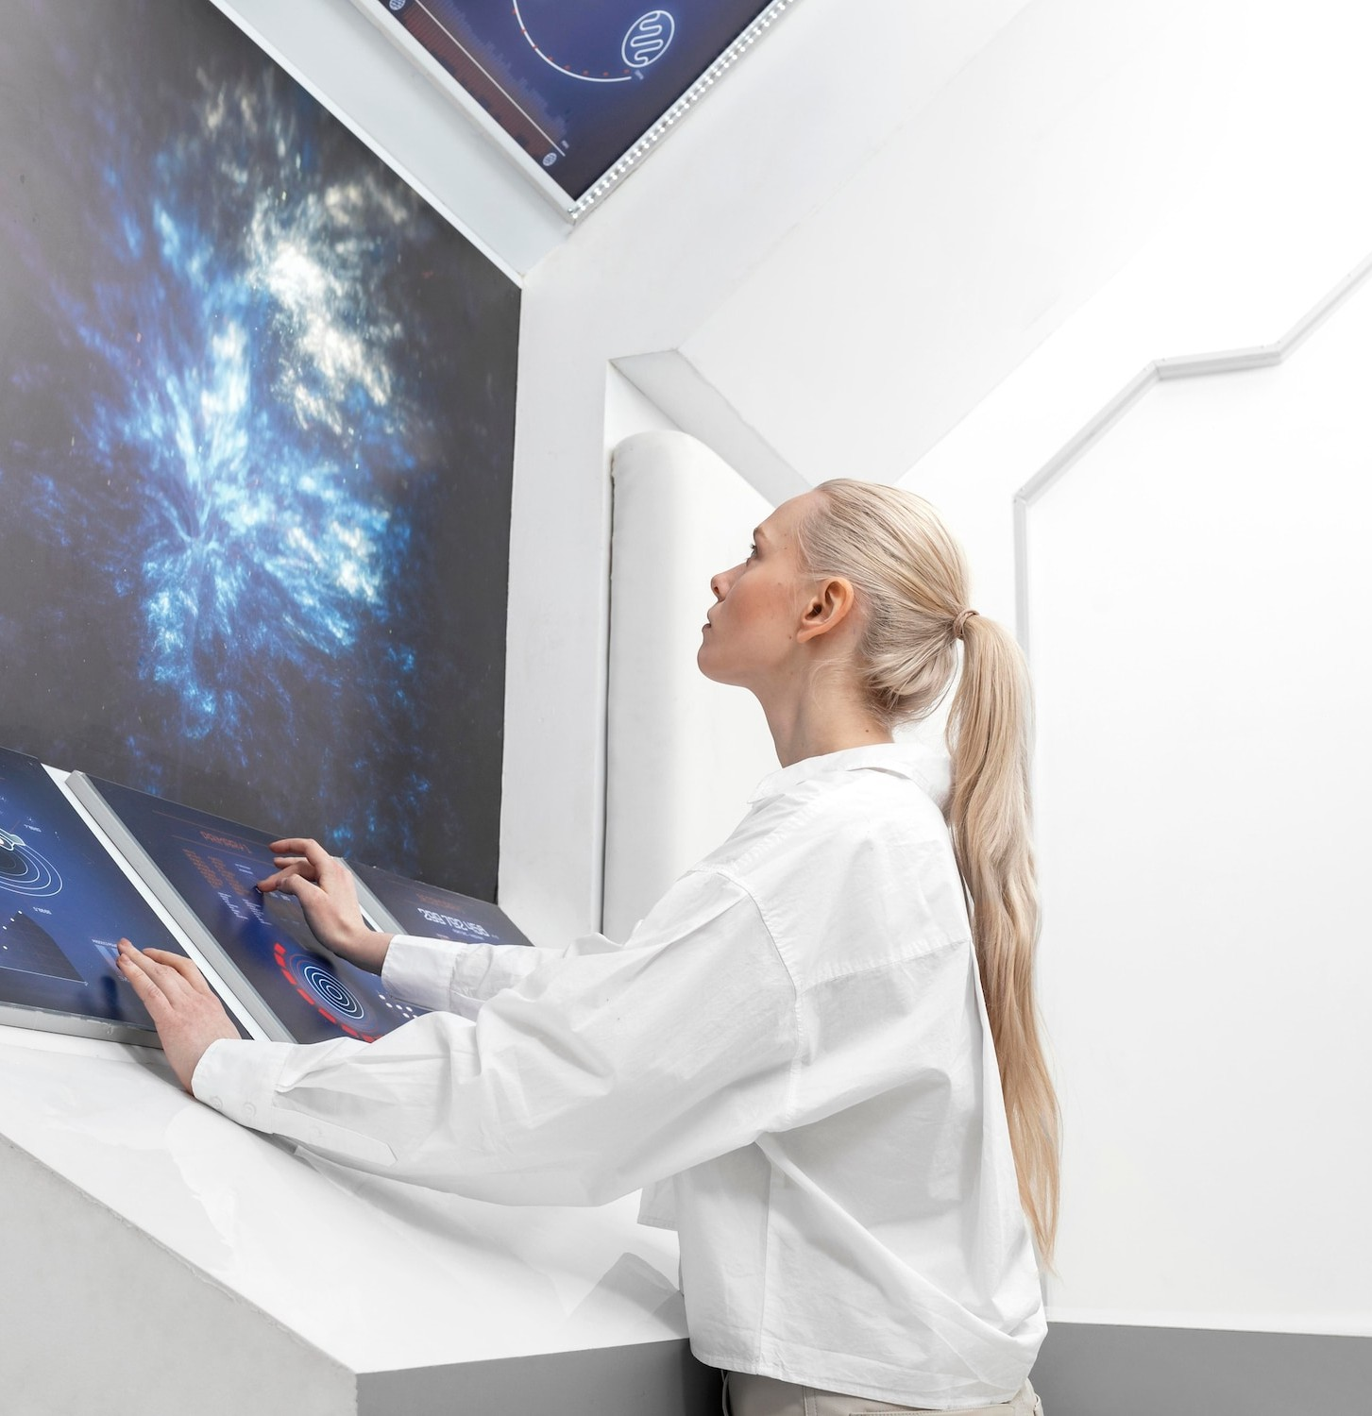
Future Implications and Innovations
The future of facial recognition holds immense potential for advancements in augmented reality, healthcare, and personalized services. As the technology continues to evolve, its impact on various industries and everyday life is poised to expand exponentially.

Slide 11
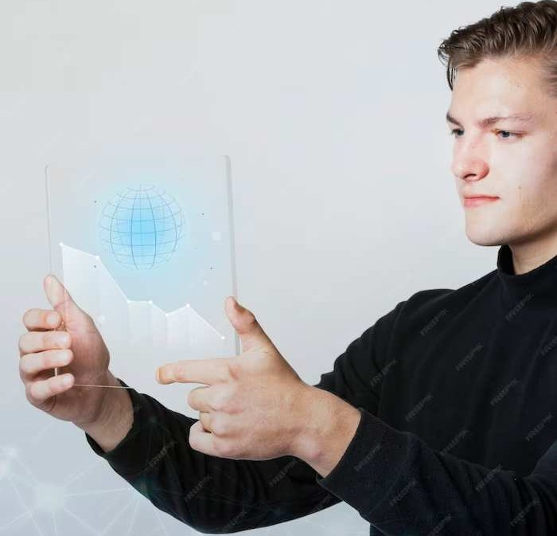
Security and Privacy Regulations
Governments and regulatory bodies are actively working to establish guidelines and regulations for the ethical use of facial recognition technology.
Striking a balance between security and privacy is paramount, and the implementation of transparent and accountable practices is essential.

Slide 12

Industry Adoption and Investment
Various industries, including retail, hospitality, and banking, are investing in facial recognition technology to enhance customer experiences and security measures. The widespread adoption signifies the growing confidence in the capabilities and potential of this innovative technology.

Slide 13
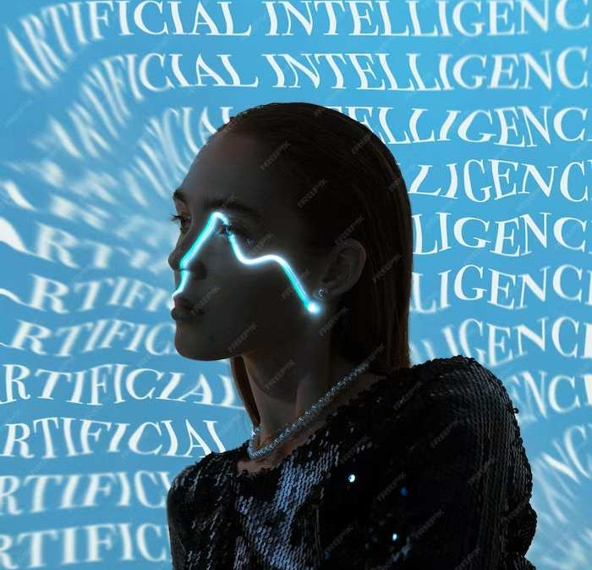
Conclusion
Facial recognition technology has evolved into a powerful tool, revolutionizing security and efficiency across industries. As advancements continue, it is imperative to address ethical considerations and regulatory frameworks to ensure responsible and beneficial deployment of this transformative technology.

